Slide 1


NL001_Lower cushion support frame PFC
Version：V01
Date：2024/05/10

Slide 2
Revisions:
Rev. | Date | Description
V01 | 2024.05.11 | Initial release
V02 | 2024.05.13 | Added FQC station
V03 | 2024.05.22 | Added P-Offine-005 intake fabric attaching

Slide 3
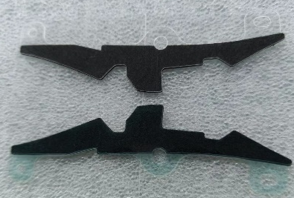
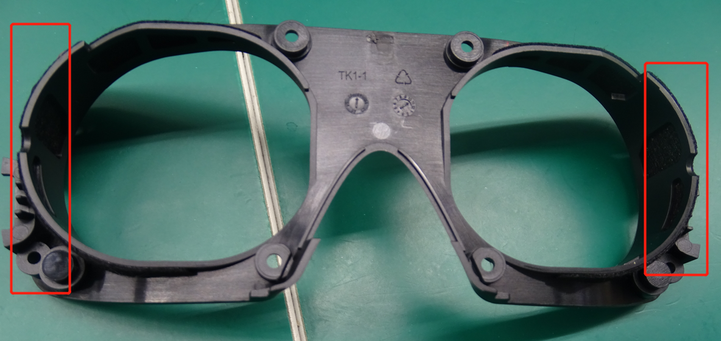
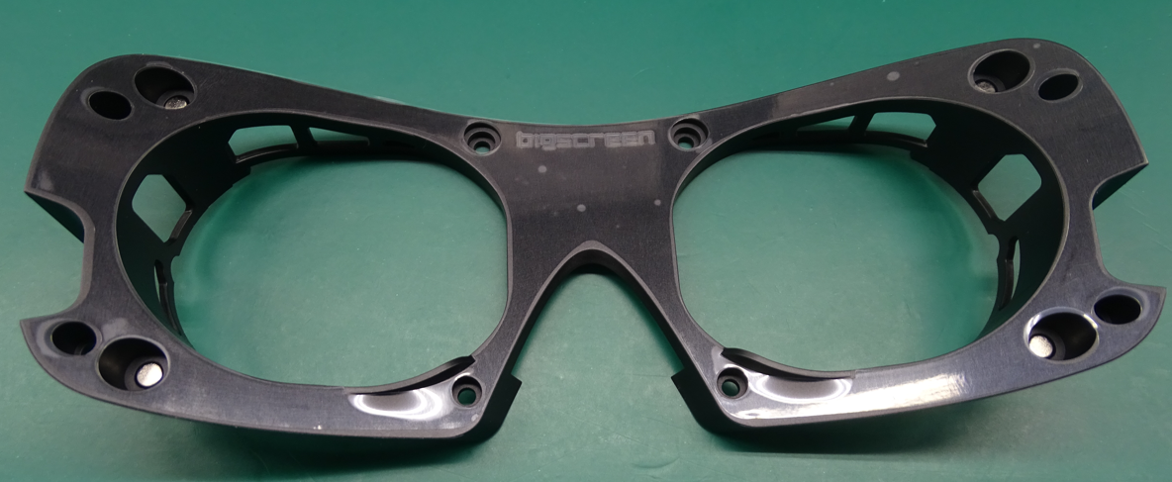
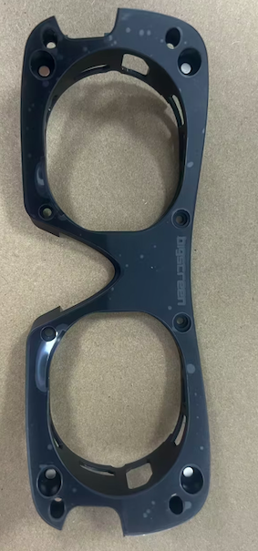
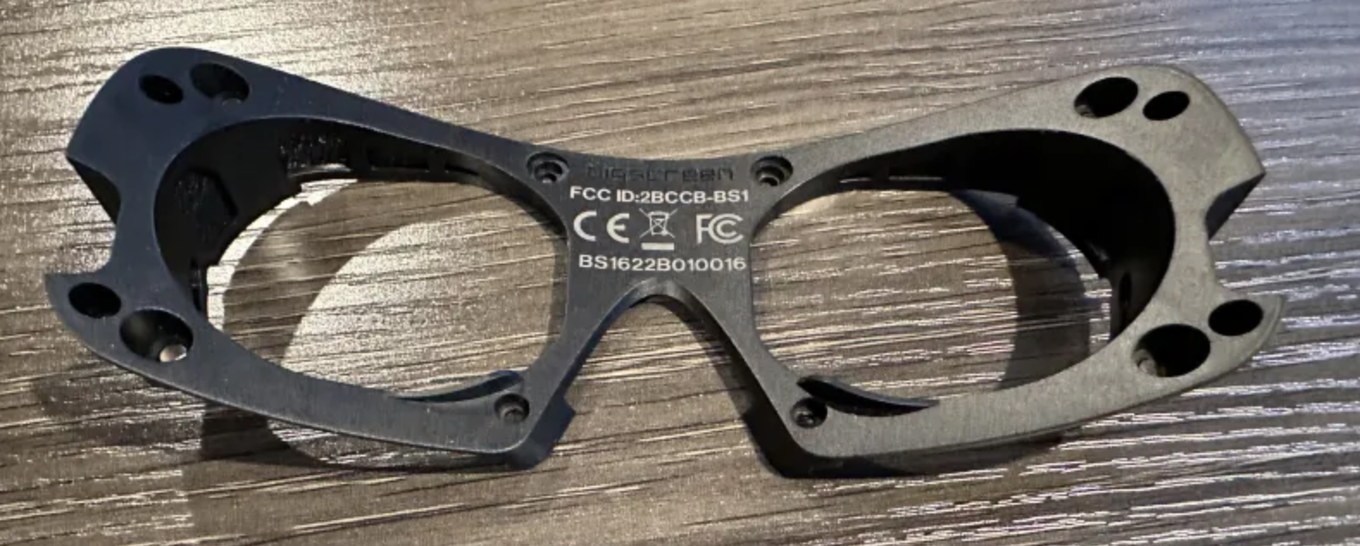
Packing-offline
MES
Test
Ass’y
Clean Booth
Inspection
P-offline-005 attach intake fabric L&R to lower cushion support frame+ pressure holding
Fabric attaching fixture
Pressure holding fixture
Computer, scanner
P-offline-010 scan SN ，laser etching，cosmetics inspection
P-offline-FQC final cosmetics inspection
Laser machine
Computer, scanner

Slide 4
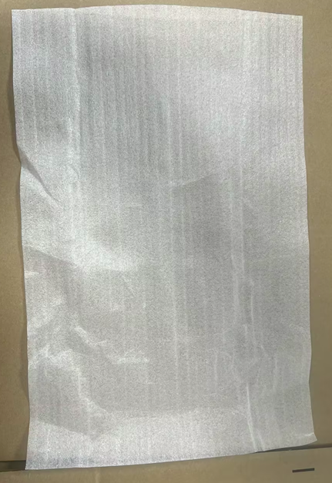
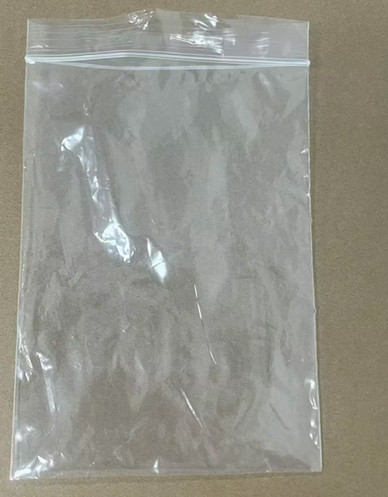
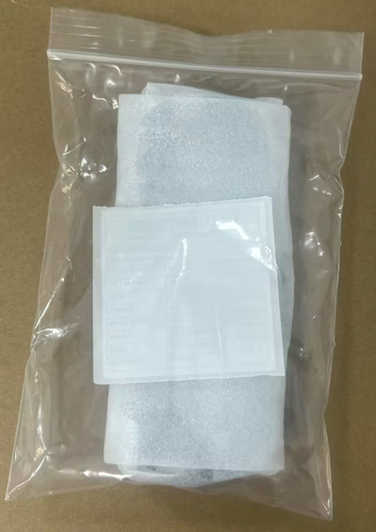
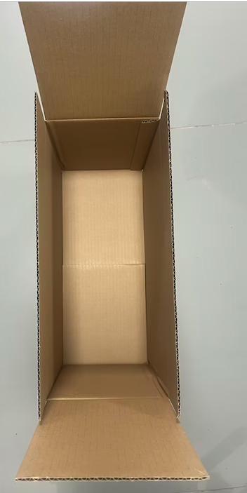
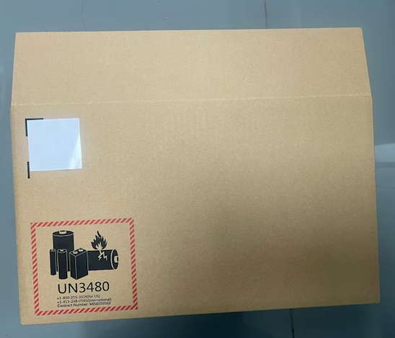
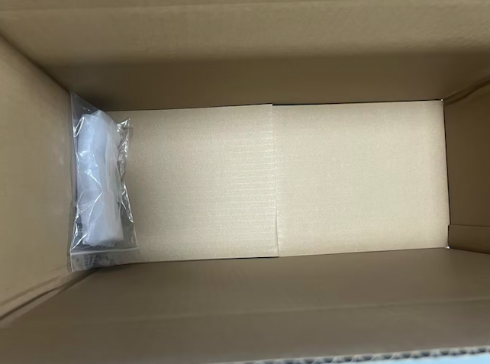
Packing-offline
MES
Test
Ass’y
Clean Booth
Inspection
P-offline-020 scan SN，print gift box label，wrap the frame with foam，and pack it with the label in a PE bag
电脑 , 扫码枪, 打印机Computer, scanner, printer
P-offline-030. place the product into the carton，12x per layer，place a separator foam，3 layers per carton；
P-offline-040. print carton label and stick on the carton.
封箱胶带，电脑，打印机
Tape, computer, printer

Slide 5
Packing-offline
MES
Test
Ass’y
Clean Booth
Inspection
P-offline-050. load cartons onto a pallet, print pallet label, apply corner protectors, wrap film, apply packing strap.
36pcs* 12 cartons*4 layers =1715pcs
电脑 扫码枪
Computer, scanner

Slide 6
Thank you

